Slide 1
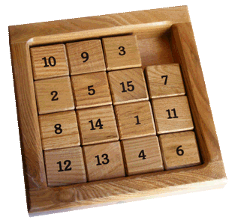
Java Slider Puzzle
Logan Boyd
Carlos Hernandez
Loraina Lampley
Sultan Shagal
Osama Sultan

Slide 2
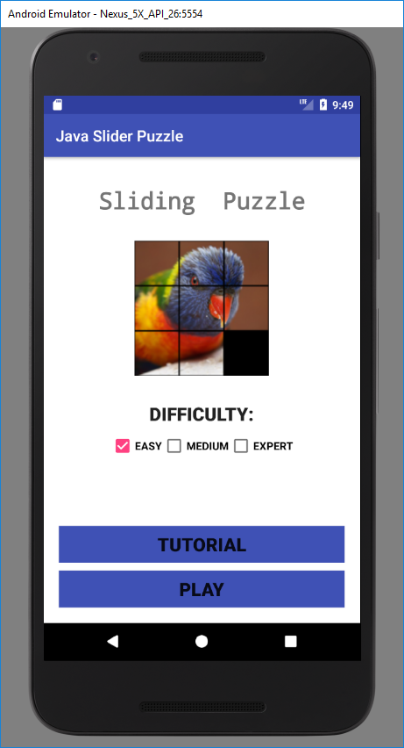
Welcome Page Sultan Shagal
Description of Layout
Image (sample puzzle)
Checkboxes (controls the level that Play links to)
Buttons (Links to tutorial and Game levels)
Media Player
Background Music
Button Click Sound
Victory Fireworks

Slide 3
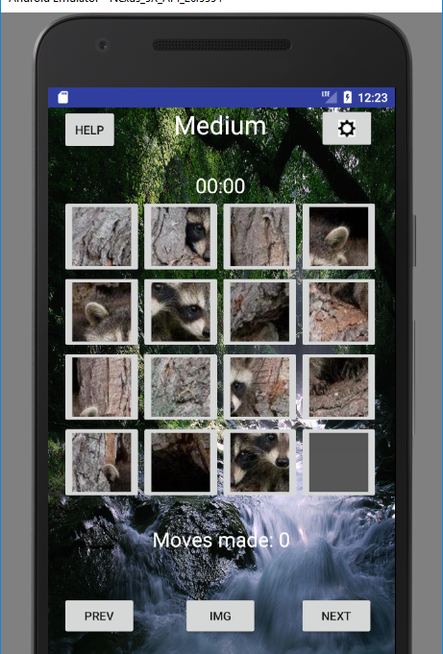
Level Layouts Description
Help
Title
Settings
Timer
Puzzle
Moves
Previous
Image
Next

Slide 4
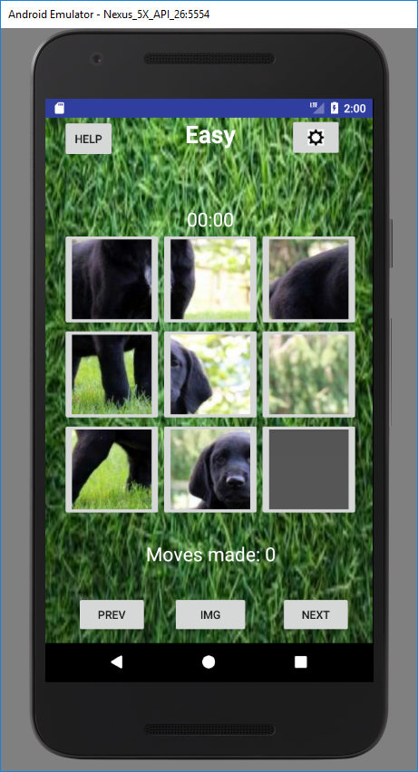
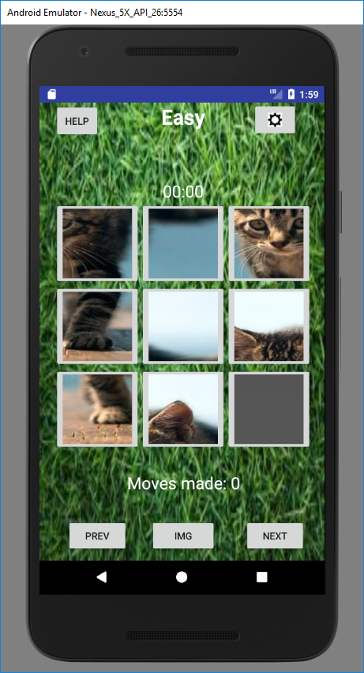
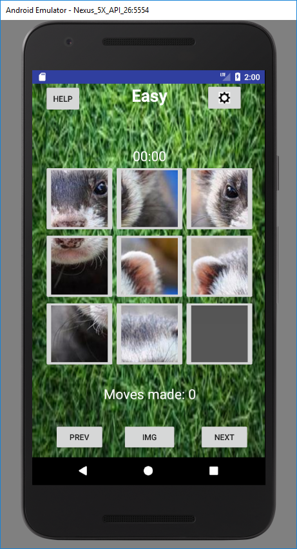
Easy Layout Osama Sultan
Description of Layout
3x3 puzzle (Image Buttons)
Alert Dialog

Slide 5
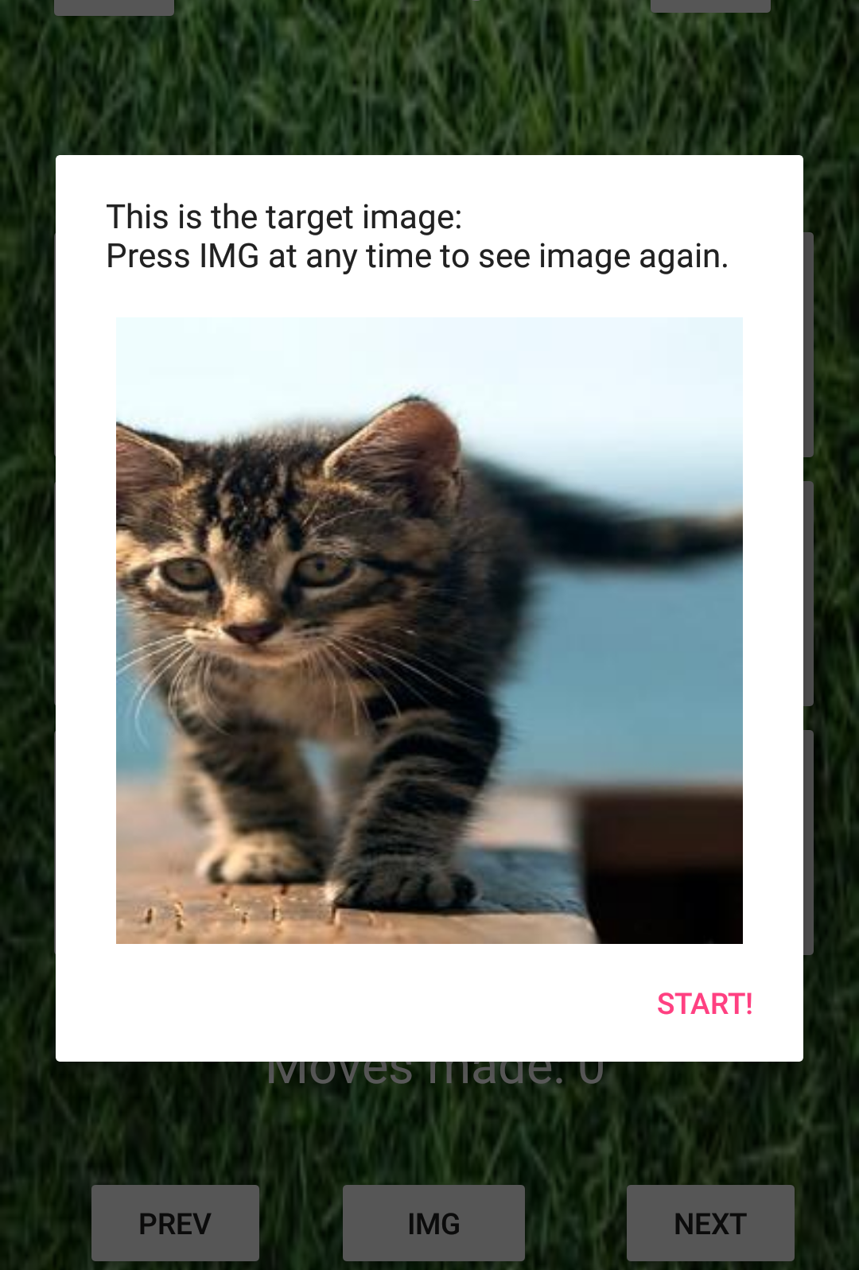
Easy Layout (Continued)
Full Image Box
Displays Full Image
Dismisses when the Start button is pushed
Alert Dialog
Features
SetView()

Slide 6

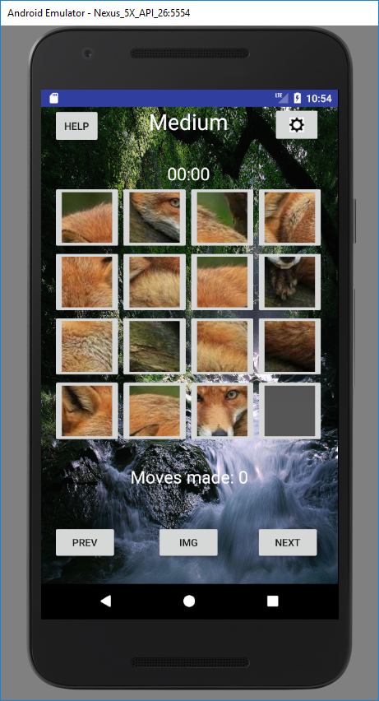
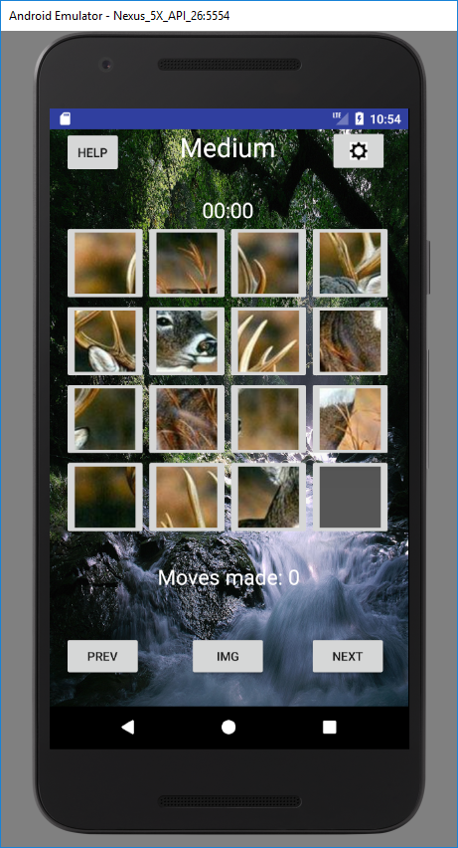
Medium Layout Logan Boyd
Description of Layout
4 x 4 Puzzle (Image Buttons)
Alert Dialog

Slide 7
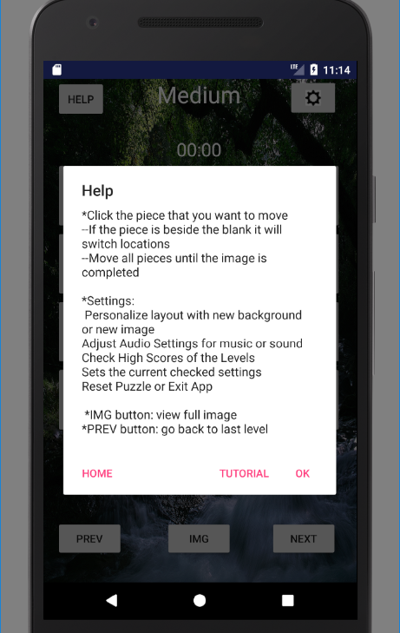
Medium Layout (continued)
Help Button
Alert Dialog
Describes the puzzle and buttons on Layout
Positive Button
OK - dismisses dialog
Negative Button
Tutorial – links back to tutorial
Neutral Button
Home - returns to welcome screen

Slide 8
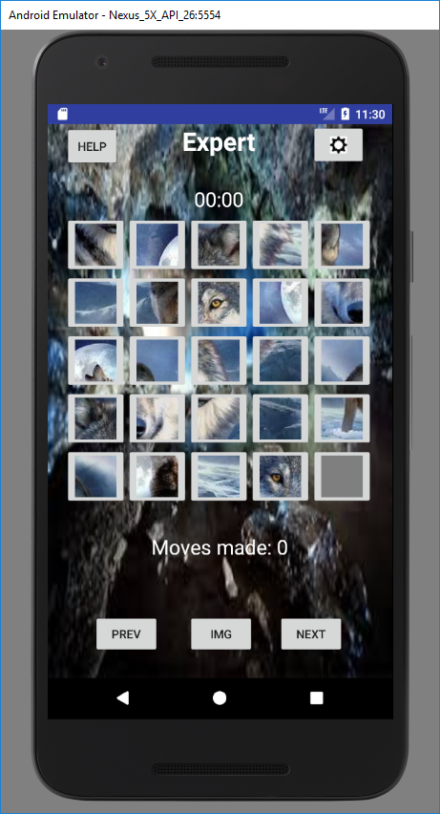
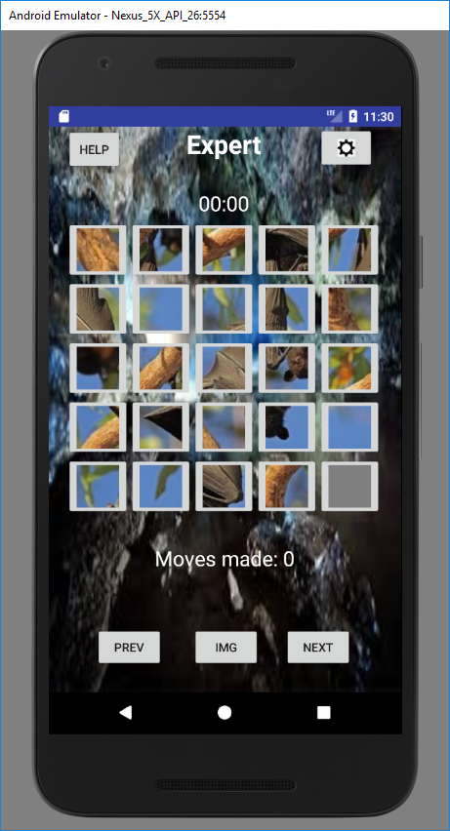
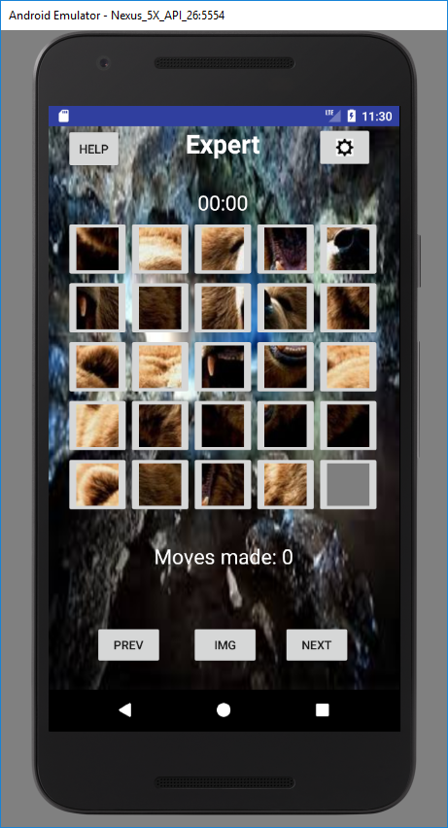
Expert Layout Loraina Lampley
Description of Layout
5x5 puzzle (Image Buttons)
Alert Dialog

Slide 9
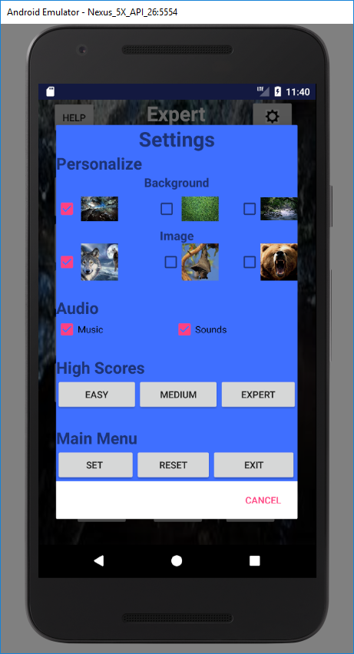
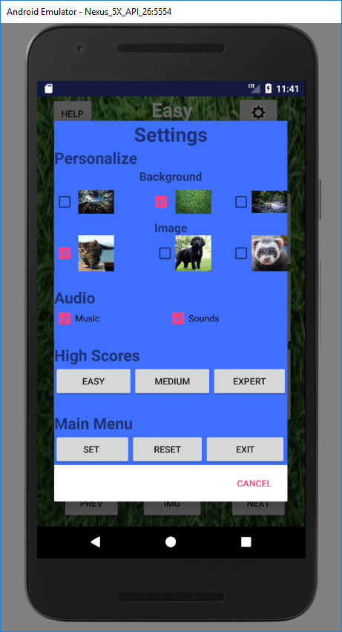
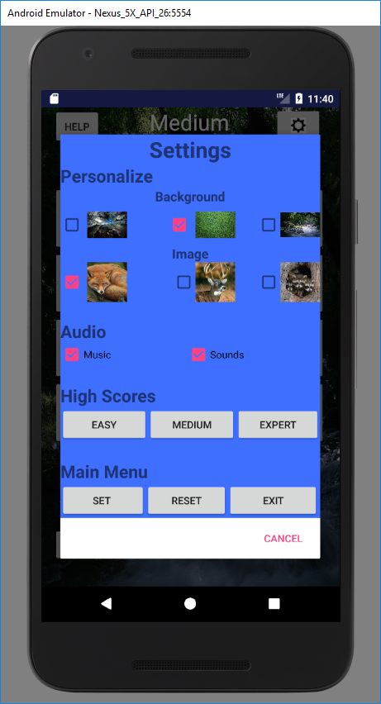
Expert Layout Continued)
Settings
Personalize
Background
Image
Audio (uncheck to disable)
Music
Sounds
High Scores
Check level high scores
Main Menu
Set – Sets checked values
Reset - Restart puzzle
Exit – Exits app

Slide 10
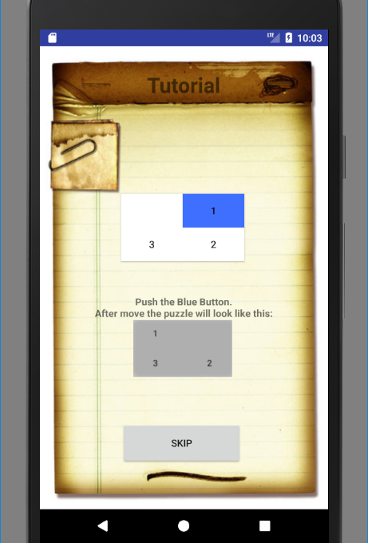
Tutorial
Description of Layout
2 x 2 puzzle (buttons)
Instructions
Button
Skip
Implementation
Puzzle Blocks moving
Animation
Victory Conditions

Slide 11
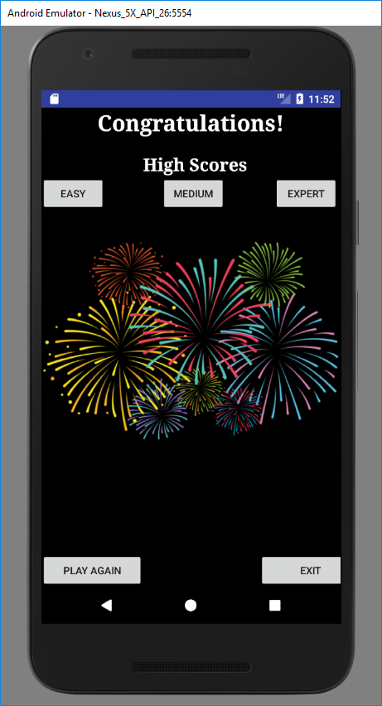
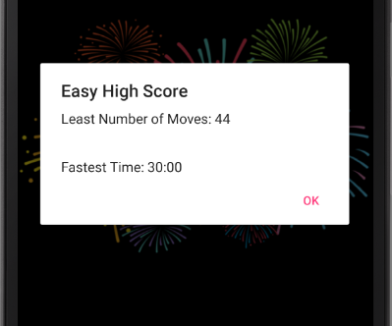
Final Layout Carlos Hernandez
Description of Layout
Buttons
High Score
Easy
Medium
Expert
Play Again
Returns to Welcome Screen
Exit
Exits the app
Alert Dialog
Scores
Shared Preferences

Slide 12
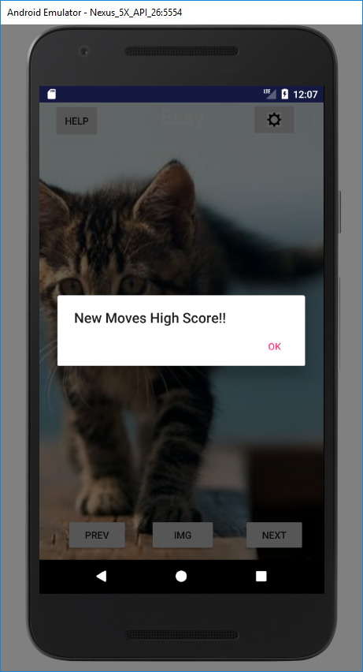
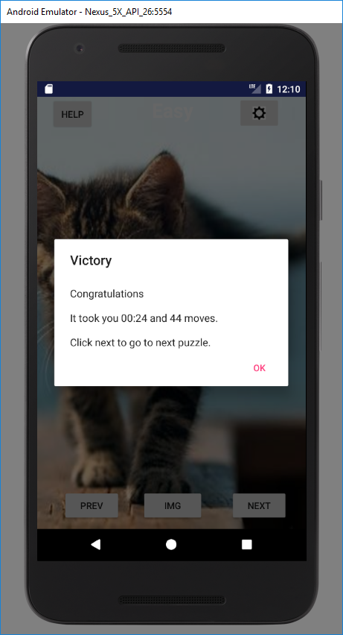
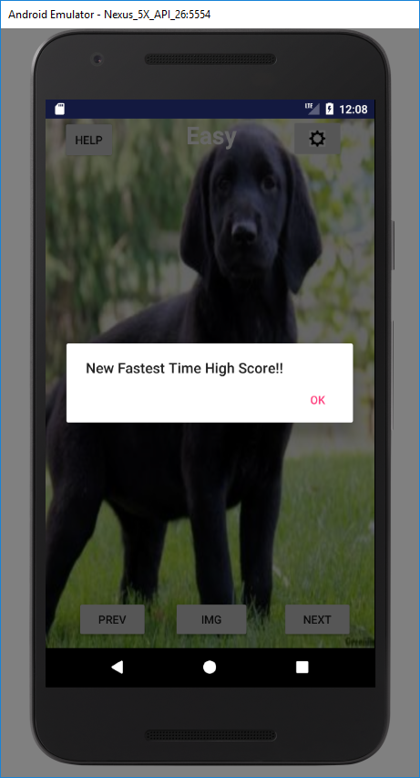
Victory Conditions and Scoring
Timer
Chronometer
Move Counter
Text View
Alert Dialogs
High Score updates
Moves
Timer
Victory Screen
Victory fireworks
Message to show score

Slide 13
Questions?

